Slide 1
Lab 3 Briefing
Angel Gomez, Ariel Fuchs, Gokul Kolady, Sharmi Shah
Notes:
8 minutes +3 min Q&A. everyone presents 2 mins

Slide 2
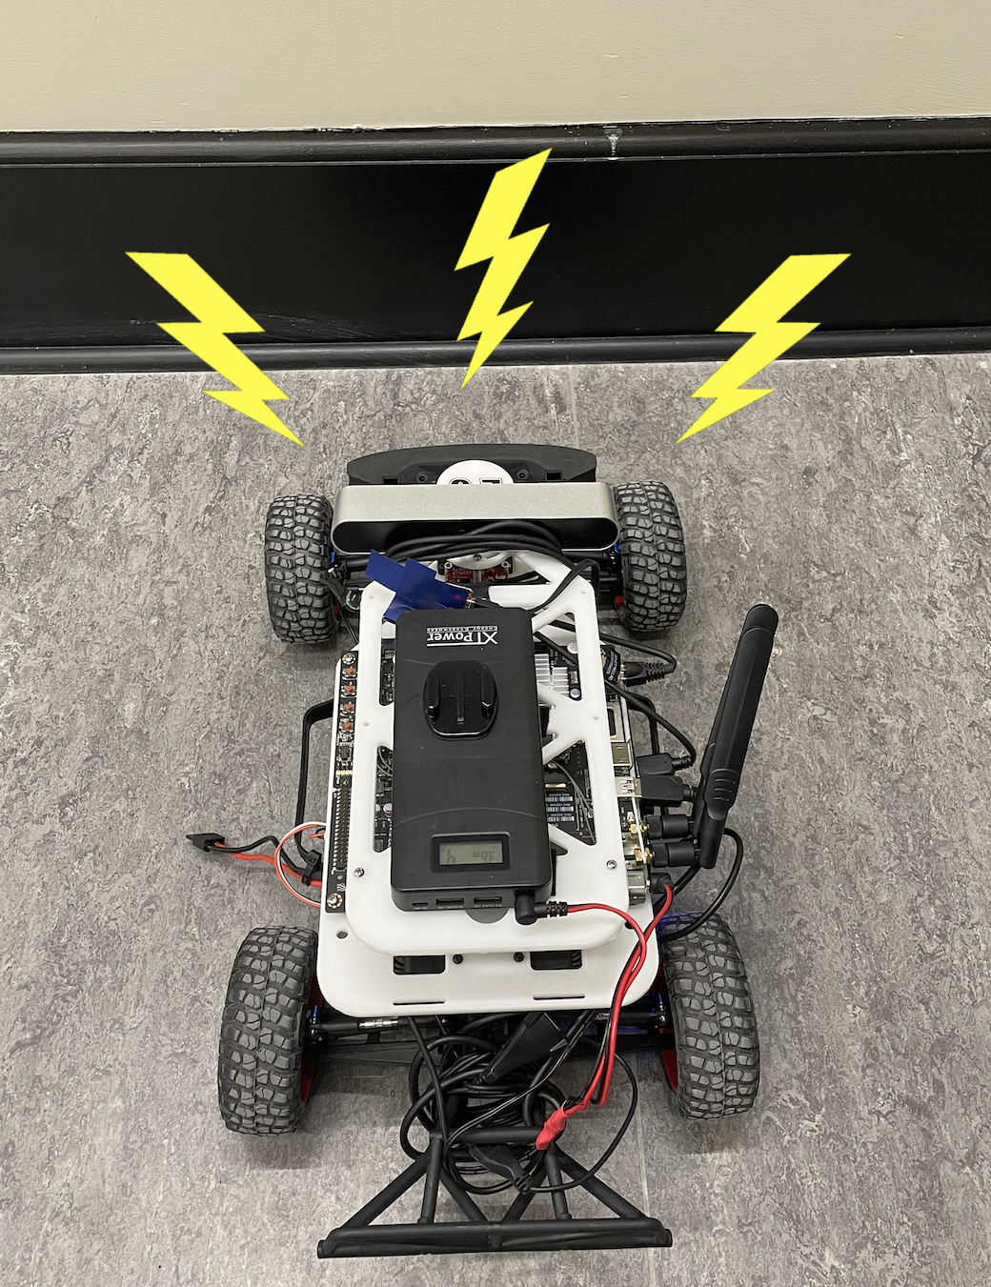
Goals of the lab
Visualizing laser scan data
Testing/tuning wall follower
Implementing safety controller
Teamwork
Establishing foundational code for long term use
Notes:
Safety!
Hardware is expensive
Don’t want to damage anyone/anything
Make sure our code is working correctly/practice our code in real life setting not just theoretica;
Teamwork
First lab with team members
Git Control
Collaborating
Getting the Car Fundamentals Down
Learn how to control the car and gain skills so by the end of the semester we will be able to have a complex autonomous vehicle
Creating code so that the robot does not crash into walls/people/other objects
Make sure the car is not ~scared~ of the wall

Slide 3
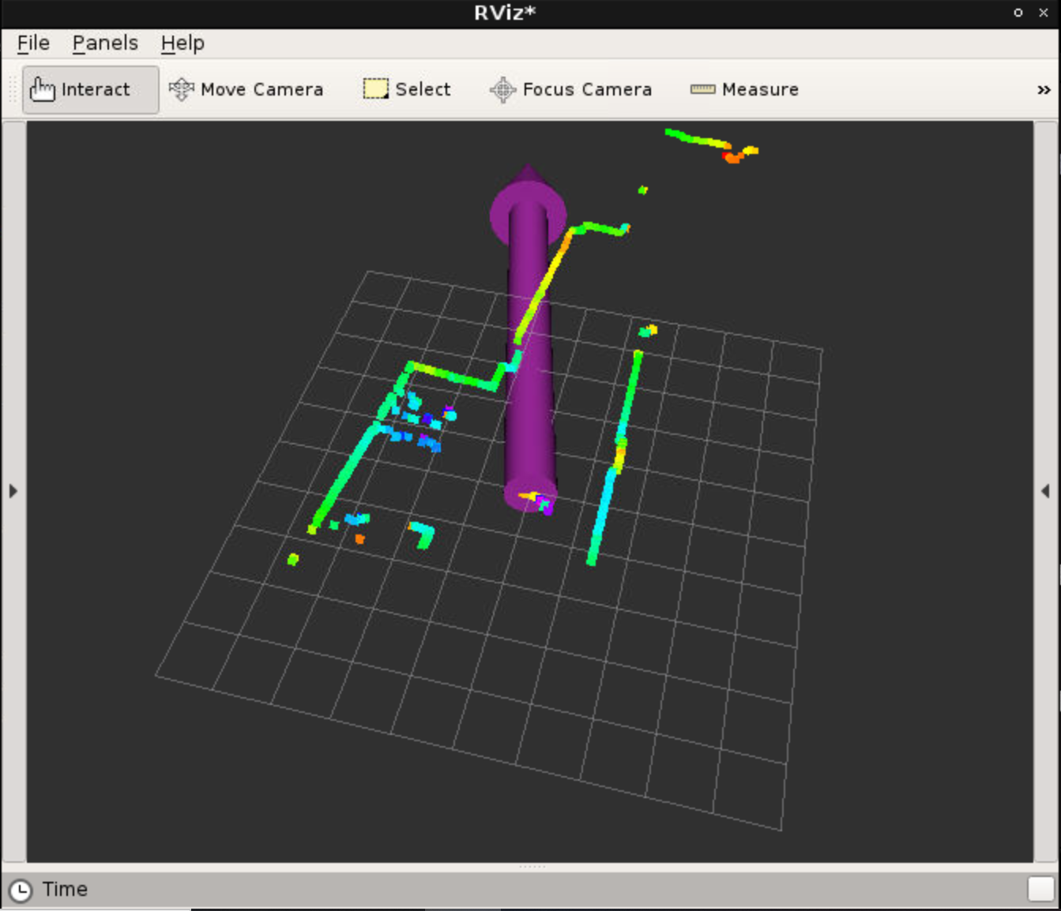
Visualizing Laser Scan

Slide 4
Goal: Create a Wall Following Program
Allow robot to follow wall automatically
Use linear regression to detect wall
Use PID control to move accordingly
Understand simulation vs. reality

Slide 5
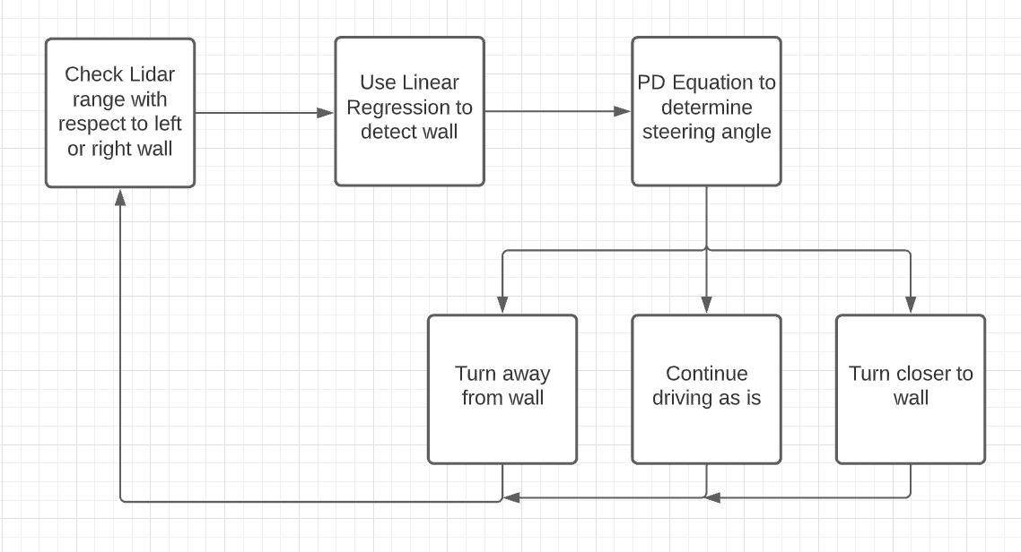
Technical Approach for Wall Following

Slide 6
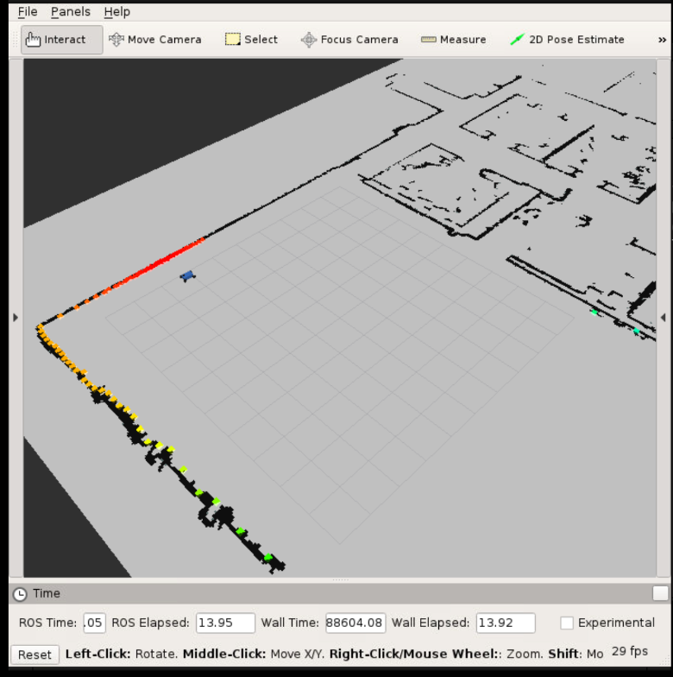
Tested Code in RVIZ and Physically
Next slides to view physical tests…

Slide 7

Wall Following Example Videos

Slide 8
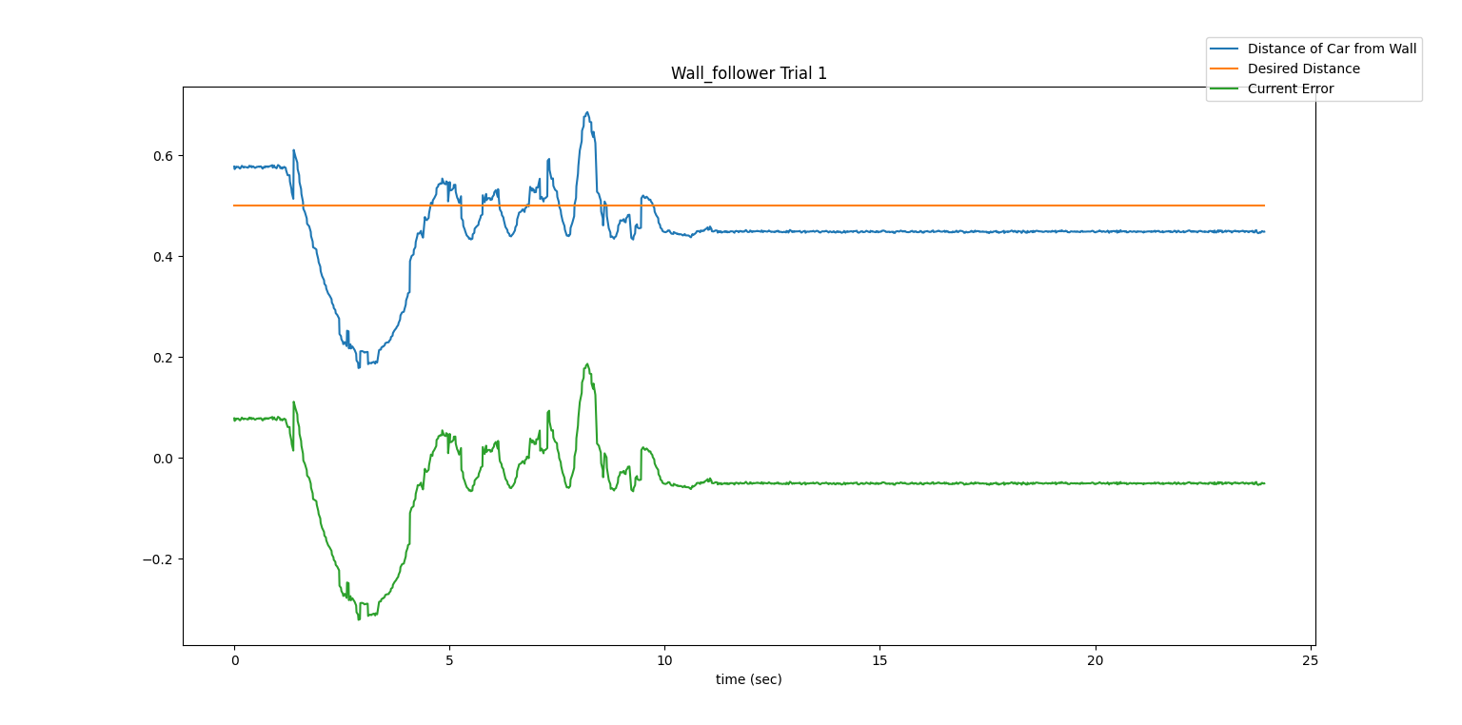
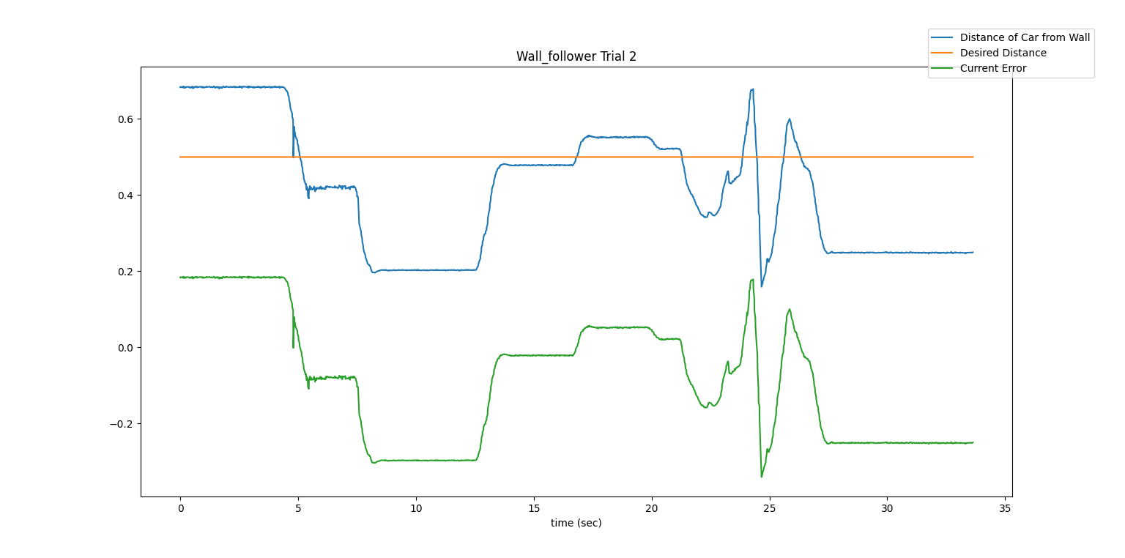
Experimental Process for Wall Following

Slide 9
Evaluation of Wall Follower
Tests
Tested both walls
Tested straight walls and corners
Works decently well, despite some oscillation
Inconsistent when following on right side
Real-world performance less robust than simulation

Slide 10
Goal: Create a Safety Controller
Robot has many expensive components
Unexpected collisions can break these components
Create a module that stops the robot 0.9m away from crashing

Slide 11
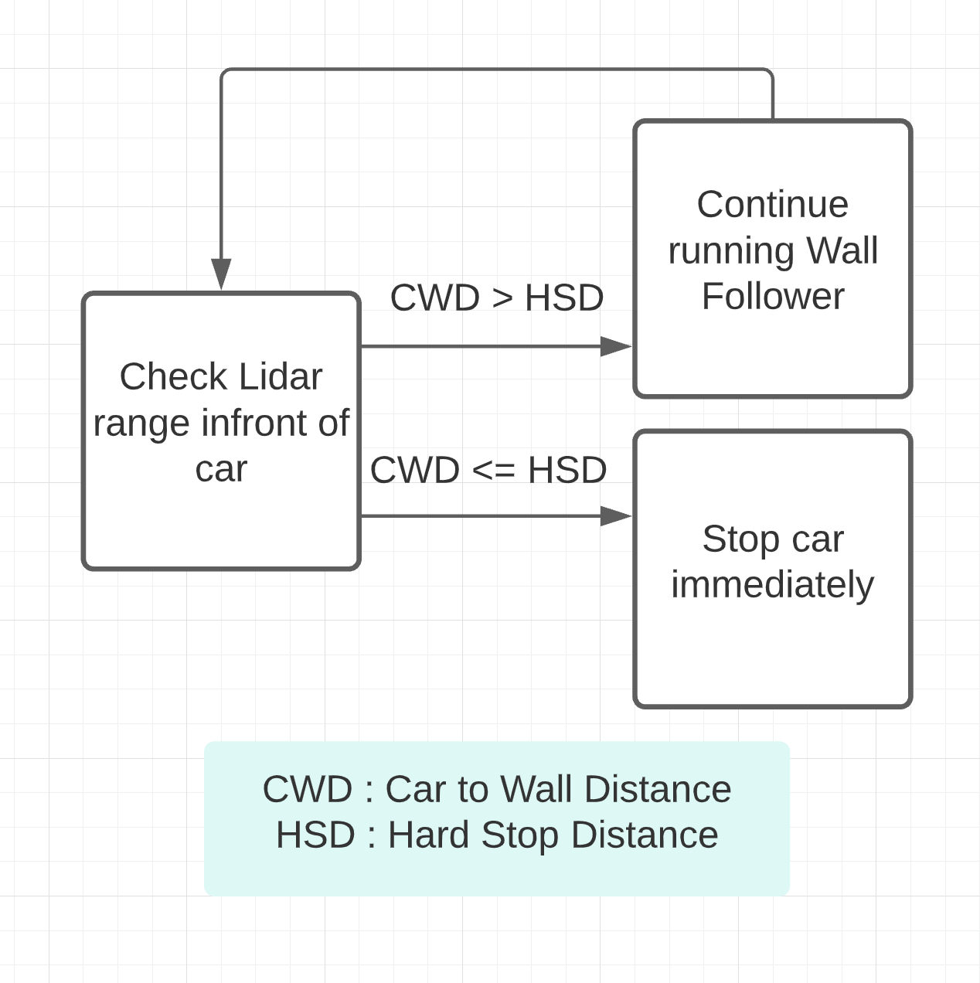
Technical Approach for Safety Controller
Order
…/nav_0
Subscribers
SCAN_TOPIC, DRIVING COMMAND
Producer
SAFETY_TOPIC

Slide 12
Trial 1: Fast Robot Stopping at the Wall

Slide 13
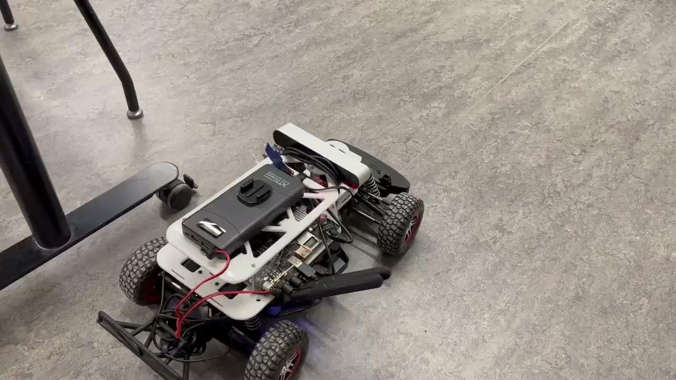
Trial 2: Slow Robot Stopping at the Wall

Slide 14
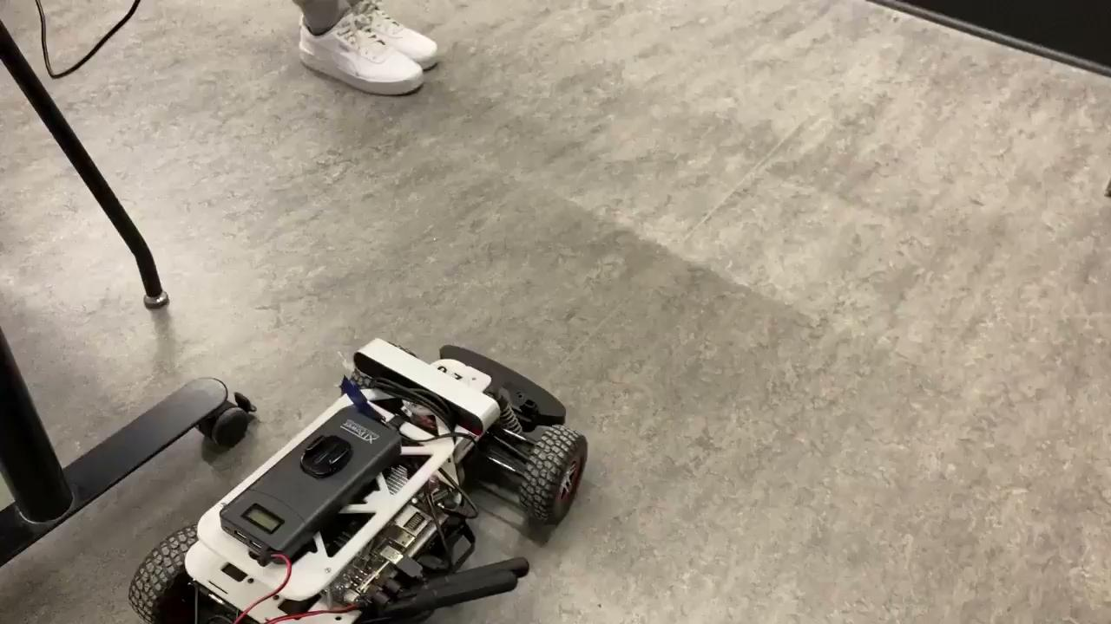
Trial 3: Preventing Unexpected Object Collision

Slide 15
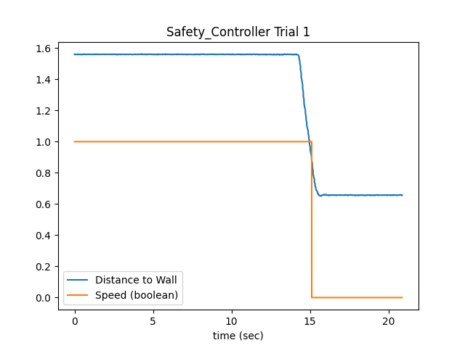
Safety Controller Trial 1 Data

Slide 16
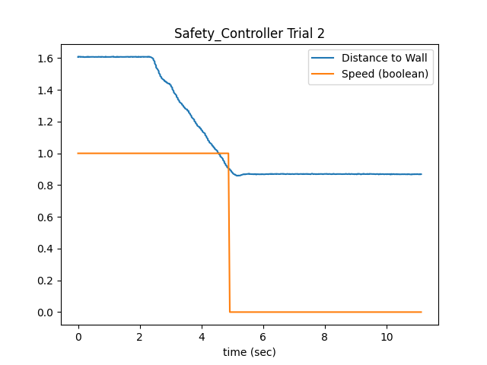
Safety Controller Trial 2 Data

Slide 17
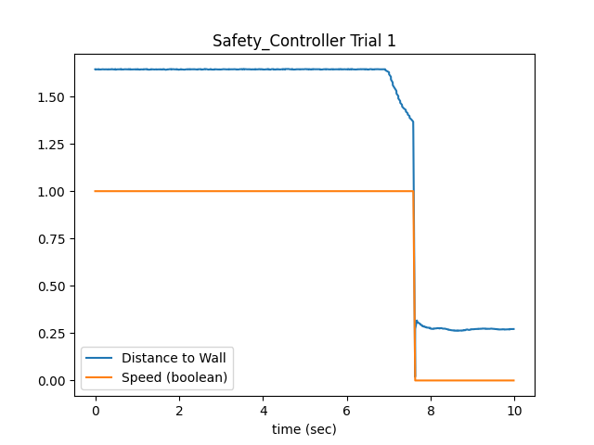
Safety Controller Trial 3 Data

Slide 18
Evaluation of Safety Controller
Tests
two different speeds (0.25, 0.75) with a 0.5m setpoint.
placing an object in front of robot while it is moving
Discovered that inertia of robot and robot velocity factor into how far robot stops from setpoint

Slide 19
Conclusion
Became comfortable with race car framework
Some room for improvement on wall following
Implemented reliable safety mechanism. May need to adjust based on speed of robot.

Slide 20
Moving Forward
Check that code is reading and writing to correct Publishers and Subscribers
Be conscious of package files and formatting
Improve workflow for testing robot
Tune wall following parameters

